Slide 1
Increase the business Profitability for Big Mountain Resort by Additional Chairlift
Hua Mo

Slide 2
Problem Statement
Big Mountain Resort in Montana offers spectacular views of Glacier National Park and Flathead Nation Forest
There are about 350,000 people ski or snowboard at Big Mountai
The resort has the largest snow making area, skiable area and night ski area
Additional chair lift is added to improve visitor distribution
The addition of chair lift will increase the cost by 5~6% of the revenue
What business opportunities will be presented

Slide 3
Recommendation and Key Findings
Additional chair lift will be needed based on the following finds:
The average area covered by per person per chair (including fast and regular lift chair) in Big Mountain Resort was lowered than the national average area covered by per person. The results indicated that this resort could absorb more people
The liftchairs in Big Mountain Resort run faster than average national liftchair to distribute the visitors. So there would be a potential damage of lifetime of the chairs. When a liftchair broke down, the distribution of the visitors will be even worse. Therefore additional liftchair will help to mitigate the issue
The statistical model was used to project the minimum amount of the chair to be added. Results showed that at least four more chairs would be needed
The overall operating cost would increase 0.5% by installing the chair. However this cost could be offset by attracting more people through improving distribution of people with additional liftchair

Slide 4
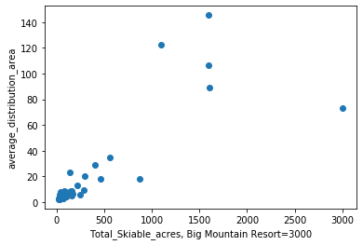
Model and Analysis(2)
Coverage per person in the skiable area
Big Mountain Resort is higher than average nation resorts
Big Mountain Resort
Other Resorts
Average coverage per person in nation

Slide 5
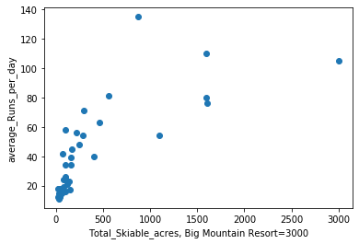
Model and Analysis(3)
Runs for the liftchair per day
Big Mountain Resort is higher than average nation resorts
Other Resorts
Big Mountain Resort
Average coverage per person in nation

Slide 6
Model and Analysis(3)
Runs for the liftchair per day
Big Mountain Resort is higher than average nation resorts
Other Resorts
Big Mountain Resort
Average coverage per person in nation

Slide 7
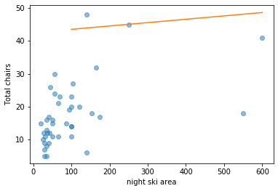
Model and Analysis(3)
Projected additional liftchair by statistical model
45 liftchair will be needed
Projected liftchair
Big Mountain Resort

Slide 8
Model and Analysis(3)
Cost Analysis
- The estimated investment is $1,450,000
- Current revenue = 350,000 people x $ 70 per person (average)
= $ 24,500,000
- % of investment on revenue = ~ 6%
- To compensate the cost, 371,000 visitor will be needed, which is a reasonable number to increase year after year
- Therefore it is viable to add additional liftchair

Slide 9
Summary and Conclusion
Due to the largest ski area of Big Mountain Resort, the current liftchair could not well distribute the visitors to more area. Therefore additional liftchair will be recommended to added.
The increasing cost can be compensated by attracting more people to the resort

